Slide 1
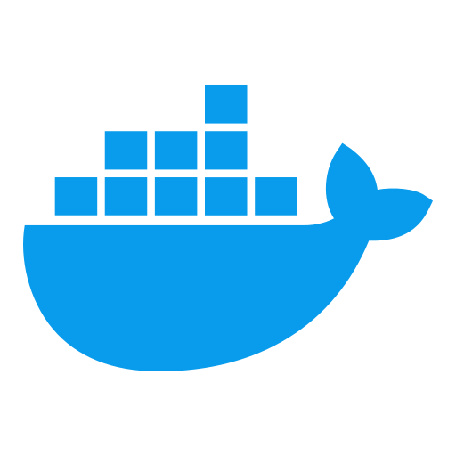
MODULE I: VIRTUALIZATION TO CONTAINERIZATION TRANSITION
Docker & Containerization Workshop
By TALHA

Slide 2
Learning Objectives
Understand the fundamental differences between VMs and containers
Identify the technical and business advantages of containerization
Recognize Docker's architecture and core components

Slide 3
Evolution of Infrastructure Virtualization
Traditional Physical Infrastructure: The Past
One application per server model
Low resource utilization (10-15%)
Slow provisioning times
High capital and operational expenses

Slide 4
Traditional Physical Infrastructure Challenges
Hardware Provisioning Challenges
Procurement cycles: Weeks to months
High upfront capital expenditure
Over-provisioning to handle peak loads
Resource Inefficiency
Typical server utilization: 10-15%
Power, cooling, and space waste
Operational Complexity
Physical maintenance requirements
Hardware lifecycle management

Slide 6
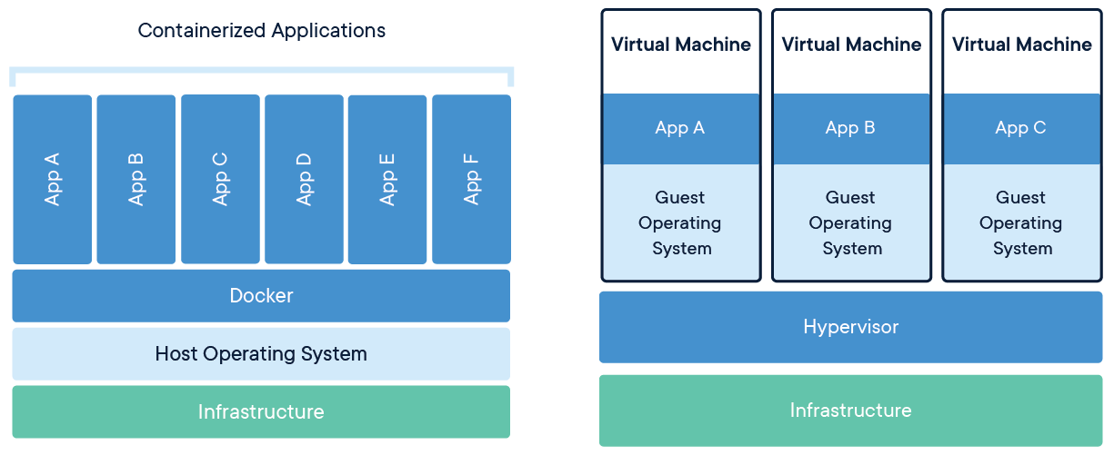
Virtual Machine Architecture
Virtual Machine Concept
Hardware-level virtualization
Full OS per VM
Hypervisor layer

Slide 7
Virtual Machine Deep Dive
Hypervisor Types
Type 1: Bare metal (ESXi, Hyper-V, KVM)
Type 2: Hosted (VirtualBox, VMware Workstation)
Isolation Mechanism
Hardware-level isolation
Complete environment separation
Resource Requirements
Full OS per VM (1-2GB minimum RAM)
Duplicated OS kernels
Storage overhead

Slide 9
Containerization Breakthrough
Container Concept
Application-level virtualization
Shared OS kernel
Lightweight packaging

Slide 10
Containerization Technical Foundation
Linux Kernel Features
Namespaces: Process isolation
Control Groups (cgroups): Resource limitations
UnionFS: Layered file systems
Container Advantages
Startup time: <1s vs 30-60s for VMs
Resource footprint: 10-100MB vs 1-10GB for VMs
Higher density: 10-100x more instances per host

Slide 11
VM vs Container Comparison
Characteristic | Virtual Machines | Containers
Virtualization | Hardware-level | OS-level
Guest OS | Required | Not required
Isolation | Complete | Process-level
Size | GBs | MBs
Boot time | Minutes | Seconds
Performance | Overhead | Near-native
Portability | Limited | High

Slide 12
The OCI Standards
Open Container Initiative
Industry standards for container formats and runtimes
Runtime Specification
Image Specification
Distribution Specification
Benefits
Interoperability
Vendor neutrality
Innovation acceleration

Slide 13
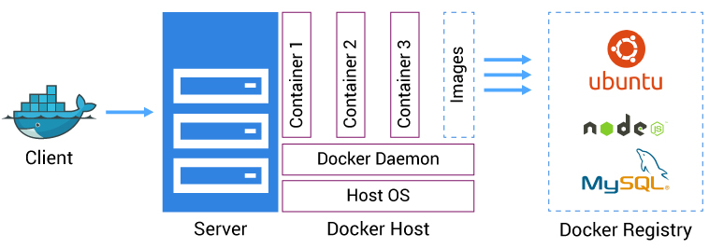
Docker Ecosystem Architecture
Docker Platform Overview
Client-server architecture
Components working together
Extensible plugin system

Slide 14
Docker Foundational Components
Docker Engine
Docker daemon (dockerd)
containerd (container supervisor)
runc (container runtime)
Docker Client
Command-line interface
REST API communication
Docker Registry
Docker Hub
Private registries
Image distribution system

Slide 16
Core Technical Concepts
Images
Read-only templates
Layered file system
Build once, run anywhere
Containers
Running instances of images
Isolated processes
Stateful execution
Docker's Copy-on-Write Strategy
Base layers shared
Only modified files stored
Efficient storage utilization

Slide 17
Container Isolation and Security
Isolation Boundaries
Process namespace isolation
Network namespace isolation
Mount namespace isolation
Security Considerations
Kernel sharing implications
Capability restrictions
User namespace mapping

Slide 18
Kubernetes Container Runtime Interface
CRI Architecture
Standard interface for container runtimes
Abstraction layer
Runtime-agnostic orchestration
Supported Runtimes
containerd
CRI-O
Docker (via dockershim, deprecated)

Slide 19
Enterprise Adoption Case Study
Financial Services Sector Transformation
Large bank modernization project
Legacy systems to microservices
Security and compliance considerations
Business Drivers
Time-to-market acceleration
Development agility
Infrastructure efficiency
Cost reduction

Slide 20
Containerization Impact Metrics
Deployment Frequency
Before: Bi-weekly releases
After: Multiple daily deployments
Utilization & Performance
50-70% reduction in infrastructure costs
Server consolidation ratio: 20:1
Startup time: Minutes to seconds
Consistent environments

Slide 21
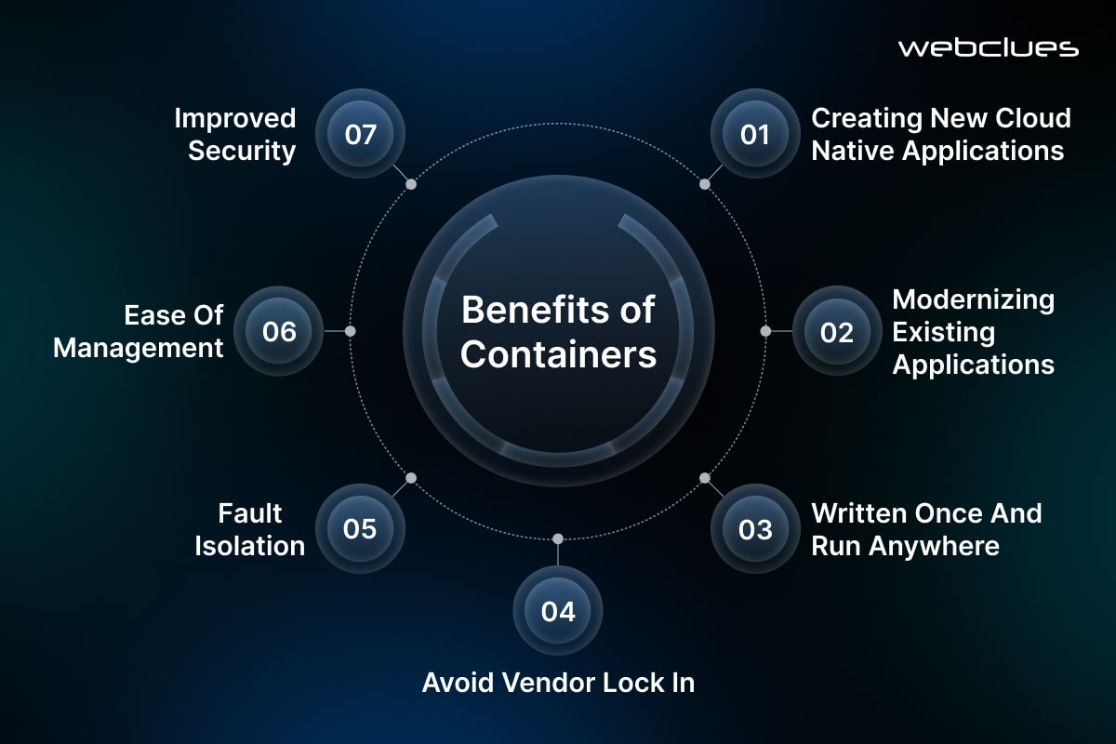

Slide 22
Architecture Transformation Journey
Transformation Phases
Assessment and planning
Pilot project implementation
Platform establishment
Application modernization
Scaled adoption

Slide 23
Domain-Specific Applications
Document Processing Opportunities
OCR pipeline containerization
Scalable document analysis
Consistent processing environments
Identity Verification Systems
Modular verification components
Scalable authentication services
Secure data processing pipelines
Database Services Strategy
Stateful containers considerations
Data persistence patterns
High-availability configurations

Slide 25
Hands-on Assessment
Container vs. VM Resource Utilization Comparison
Exercise objectives
Setup instructions
Measurement methodology
Expected outcomes

Slide 26
Key Takeaways
Containers provide lightweight, efficient application packaging
Docker ecosystem offers standardized, portable containerization
Containerization enables faster deployments and better resource utilization
Enterprise transformation requires technical and organizational adaptation
Domain-specific applications benefit from containerized architecture

Slide 27

Questions?

